Slide 1
Revisiting Sentiment Analysis from Neural Network Perspective
Jiaxi Tang @ Simon Fraser University
jiaxit@sfu.ca

Slide 2
Agenda
Agenda
Part 1: Sentiment Analysis from past（5min）
Representation: Bag-of-words model
Method: KNN
Issues
Part 2: Neural network(15min)
Representation: Word Embedding
Method: CNN
Part 3: Practice(15min)
Code flow
Forward / Backward propagation
Part 4: FAQ(15min)

Slide 3
Representation: Bag-of-words Model [1]
[ "John",
"likes",
"to",
"watch",
"movies",
"also",
"football",
"games",
"Mary",
"too" ]
John likes to watch movies. Mary likes movies too.
John also likes to watch football games.
original sentence
[1, 2, 1, 1, 2, 0, 0, 0, 1, 1]
[1, 1, 1, 1, 0, 1, 1, 1, 0, 0]
vocabulary
bag-of-words representation
Part 1: Sentiment Analysis from past
[1] https://en.wikipedia.org/wiki/Bag-of-words_model

Slide 4
Representation: N-gram
[ "John",
"likes",
"to",
"watch",
"movies",
"also",
"football",
"games",
"Mary",
"too" ]
[ “John likes”,
"likes to",
"to watch",
"watch movies",
"Mary likes",
"likes movies",
"movies too", ]
John likes to watch movies. Mary likes movies too.
John also likes to watch football games.
Conceptually, we can view bag-of-word model as a special case of the n-gram model, with n=1
bigram feature
unigram feature
Part 1: Sentiment Analysis from past

Slide 5
Method: K-Nearest Neighbor
Data:
Representation
Label:
It is fantastic
It is ultimately unsatisfying
A mediocre film
[1,1,1,0,0,0,0,0]
[1,1,0,1,1,0,0,0]
[0,0,0,0,0,1,1,1]
1
0
0
It is ultimately mediocre film
predict
0
[1,1,0,1,0,0,1,0]
Part 1: Sentiment Analysis from past

Slide 6
Issue:
I like it, 1
I don’t like it
predict
1
sparsity will lead to terrible performance!
Part 1: Sentiment Analysis from past

Slide 7
Representation: Word Embedding
Each word is associated with a vector(embedding) of latent values, e.g.
“like” = [0.7, 0.1, -0.5, 0.4, 1.2]
Part 2: Neural network

Slide 8
Bag-of-words vs. Word Embedding
Bag-of-words
Word embedding
Each value has explicit meaning
Very sparse
Usually don’t have
contextual information
Values are latent, don’t know the meaning
Dense real values
Have contextual information
Part 2: Neural network

Slide 9
Representation: Word Embedding
two ways to get word embedding:
(1) Initialize word embedding with random value, train them on the given dataset,
and learn their optimal value.
(2) Use existing word embedding trained from other datasets.
Google word2vec: https://code.google.com/archive/p/word2vec/
GloVe: https://github.com/stanfordnlp/GloVe
Try (1) first, then use (2)
Part 2: Neural network

Slide 10
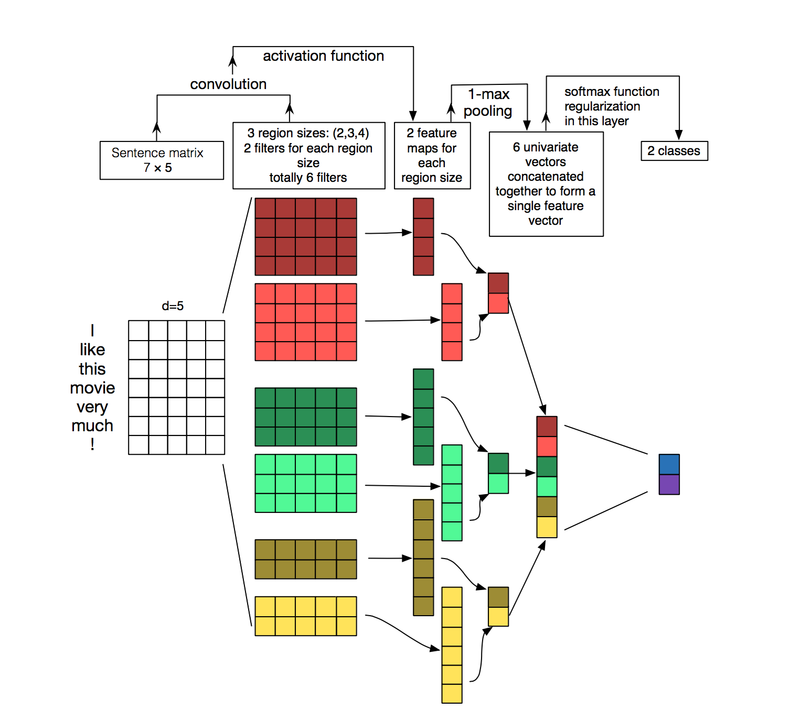
Method: CNN model
Part 2: Neural network

Slide 11
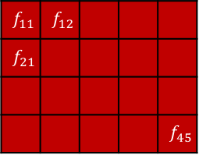
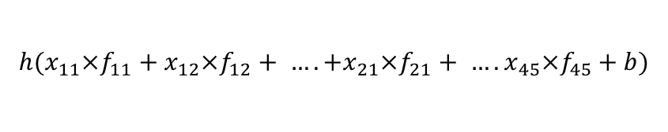
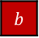

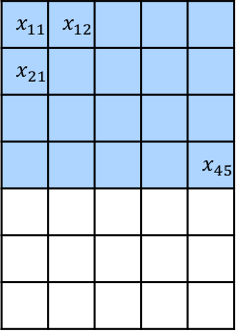
Method: CNN model – convolution
$$x_{11}$$ | $$x_{12}$$
$$x_{21}$$
 |  |  |  | $$x_{45}$$
$$f_{11}$$ | $$f_{12}$$
$$f_{21}$$
 |  |  |  | $$f_{45}$$
)
h (
$$⊗$$
+
$$b$$
=
dot product
bias of this filter
result of
convolution
filter: 4 x 5
sentence matrix:
7 x 5
=
$${h(x}_{11}×f_{11}+x_{12}×f_{12}+ …. +x_{21}×f_{21}+ ….x_{45}×f_{45}+b)$$
Part 2: Neural network

Slide 12
Method: CNN model – convolution
)
h (
$$⊗$$
+
=
dot product
bias of this filter
result of
convolution
filter: 4 x 5
sentence matrix:
7 x 5
After convolutional operation with this filter, we get 4 values:
4 x 1
Part 2: Neural network

Slide 13
Method: CNN model - pooling
pick largest one (1-max pooling)
1 x 1
4 x 1
For the total 6 filters, we get 6 values,
then we concatenate them together:
6 x 1
Part 2: Neural network

Slide 14
Method: CNN model
a filter with size = n
detect a specific n-gram feature
feature vector
embedding of this sentence
Part 2: Neural network

Slide 15
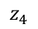
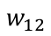
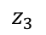
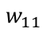
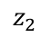
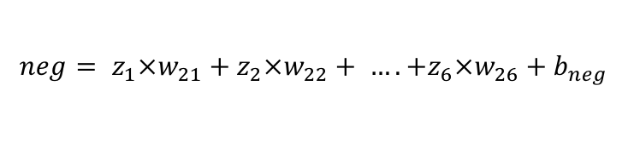
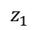
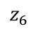
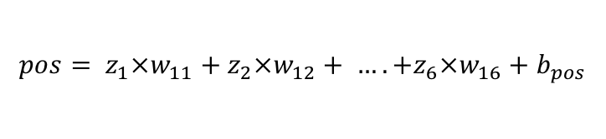
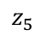
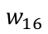
Method: CNN model – output layer, softmax loss
$$z_{1}$$
$$w_{11}$$
$$z_{2}$$
$$w_{12}$$
pos
$$z_{3}$$
neg
$$z_{4}$$
$$z_{5}$$
$$w_{16}$$
2 x 1
$$z_{6}$$
6 x 1
$${pos= z}_{1}×w_{11}+z_{2}×w_{12}+ …. +z_{6}×w_{16}+b_{pos}$$
$${neg= z}_{1}×w_{21}+z_{2}×w_{22}+ …. +z_{6}×w_{26}+b_{neg}$$
Part 2: Neural network

Slide 16
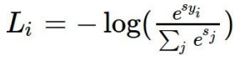
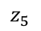
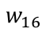
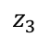
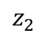
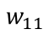
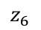
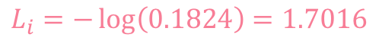
Method: CNN model – softmax loss
$$z_{1}$$
$$w_{11}$$
$$z_{2}$$
$$w_{12}$$
pos
$$z_{3}$$
neg
$$z_{4}$$
$$z_{5}$$
$$w_{16}$$
2 x 1
scores = unnormalized log probabilities of the classes
$$z_{6}$$
6 x 1
pos = -0.2 (ground truth)
neg = 1.3
exp
0.8187
3.6693
normalize
0.1824
0.8176
probabilities
$$L_{i}=−\log\left(0.1824\right)=1.7016$$
Part 2: Neural network

Slide 17
Practice: Code flow
1.Preparation
Load data and
vocabulary
Separate dataset to:
(1) training (2) validation
Initialize all variables
2.Training: (for each data)
Update parameters
Backward propagation:
compute derivatives
Forward propagation:
compute loss
3.Evaluation
Test performance on validation set
Save parameters on your disk
Part 3: Practice

Slide 18
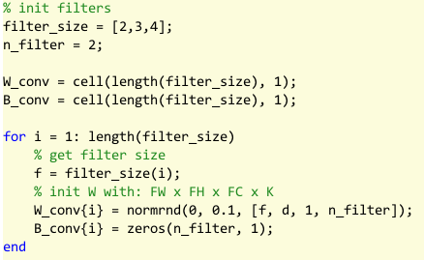
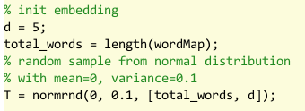
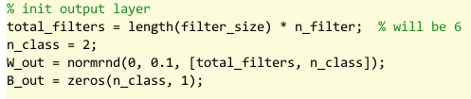
Practice: Initialization
Part 3: Practice

Slide 19
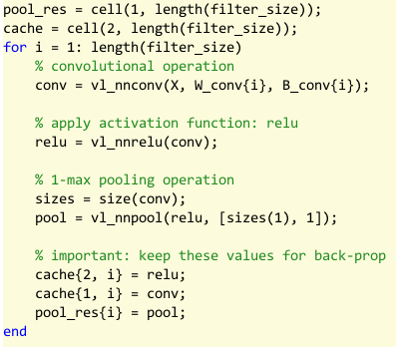
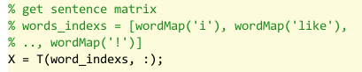
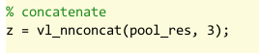
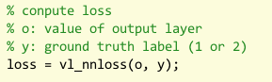
Practice: Forward propagation
Part 3: Practice

Slide 20
Practice: Backward propagation
Part2 of http://www.robots.ox.ac.uk/~vgg/practicals/cnn/
Part 3: Practice

Slide 21
Challenge:
1. split by ratio → cross-validation
2. use existing word2vec to initialize word embedding
3. regularization (l2 norm, dropout)
4. SGD → RMSProp or Adam
5. model ensembles
5. use mini-batch to accelerate
6. …
Part 3: Practice

Slide 22
FAQ
Part 4: FAQ

Slide 23
Thanks

